Slide 1
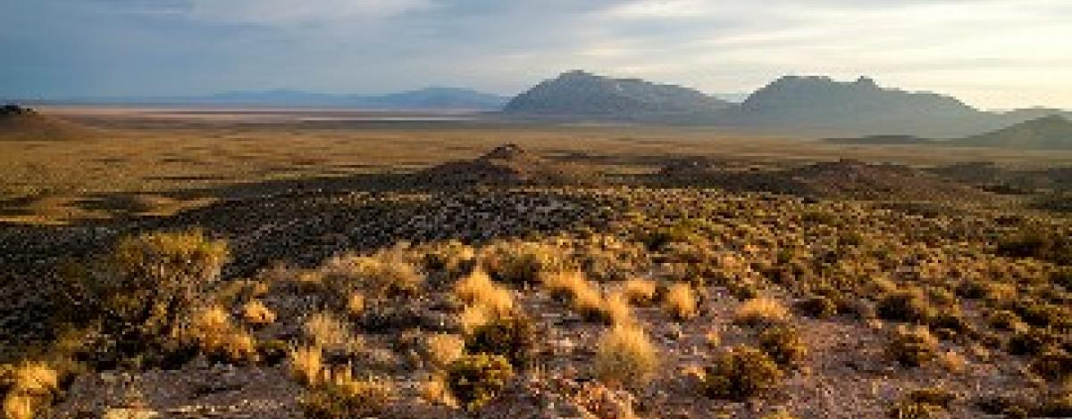
Geology of Nevada, a Discussion to Accompany the Geologic Map of Nevada
Cenozioc Tectonics
John H. Stewart

Slide 2
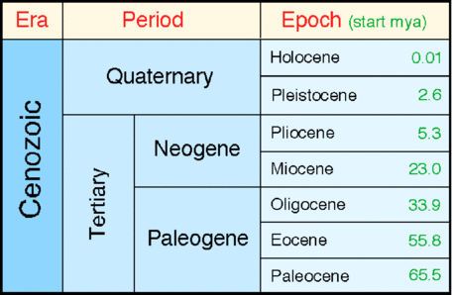
. The most important Cenozoic tectonism in Nevada consisted of crustal extension that produced the present day block-faulted basins and ranges.
. Most block faulting occurred in the late Cenozoic.
. Sparsity of sedimentary rocks shows Nevada was elevated and undergoing erosion during early Tertiary.

Slide 3
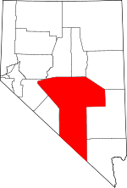
Tectonic activity and deformation in the Tertiary
. Large scale normal faulting occurred during deposition of Sheeps Pass formation (Paleocene and Eocene). *Central-East*
. Elko Formation is strongly folded and dates ~37-38 m.y. ago.
. Middle Tertiary deformation also seen in Northern Elko county.
. Coarse conglomerate at or near the base of Tertiary formations in Nye county.
THE POINT: There wasn't much tectonic activity going on across the basin and range in the Early Cenozoic.

Slide 4
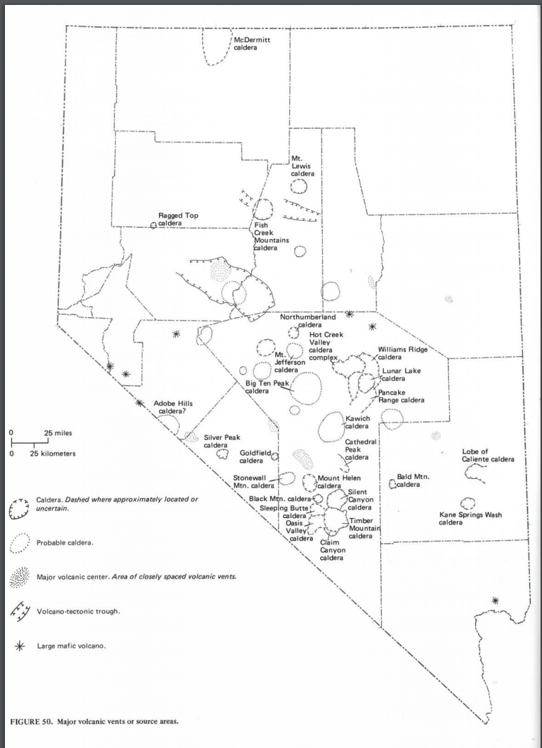
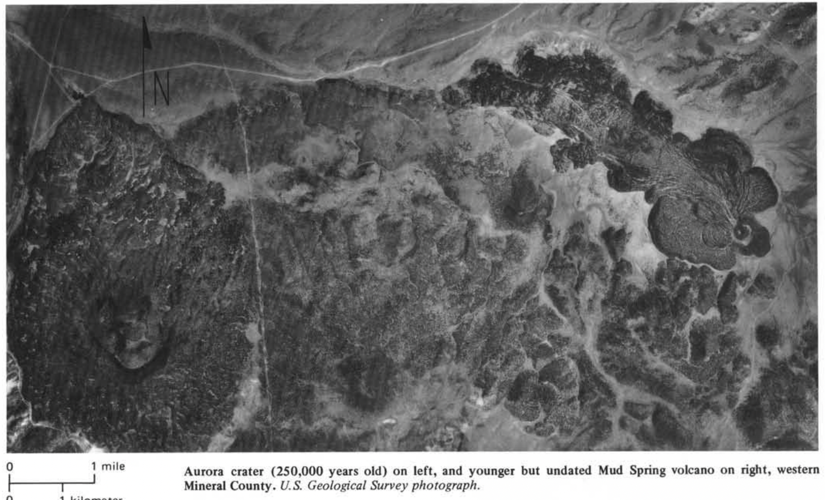
. Few structural events are recorded in Nevada except for events related to igneous activity.
. Little regional tectonic distortion took place in Nevada in the middle tertiary.

Slide 5
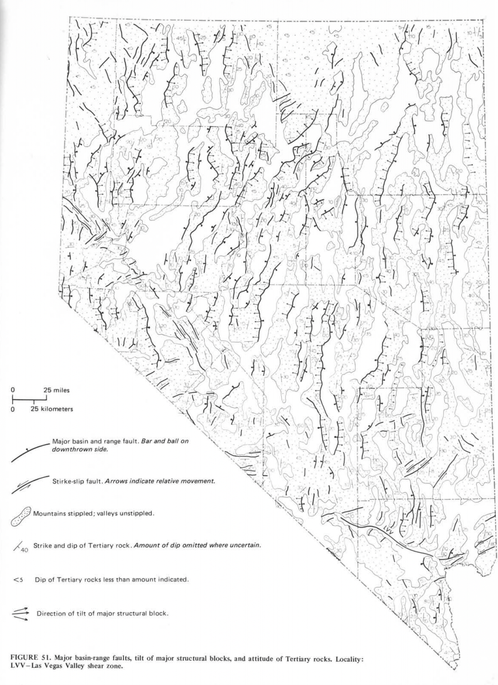
Ch-ch-changes
~ 17 m.y. ago major changes occurred such as extensional faulting.
. The basins and ranges of Nevada were produced by complex system of late Cenozoic normal faults.
. Resulting in relative uplift of linear segments to form mountains and sinking of adjacent segments to form valleys.
. “Structure is clearly the result of regional extension because normal faults that bound major mountains or valley blocks dip about 60deg and require 1 mile of extension for each 2 miles of dip-slip.”

Slide 6
. Two types of evidence used to date basin-range structure:
Indirect: Compare early Cenozoic Calc- alkilic volcanic rocks to late Cenozoic basaltic rocks mark shift in tectonics. Appears to have happened ~17 m.y.a.
Observation of the first appearance of fault-controlled sedimentary basins and topographic forms approximately resembling those seen today.
Such basins were well defined about 11-13 m.y.a.

Slide 7
Southern Nevada:
Older, early faulting (17 m.y-old) predominantly northeast and northwest.
Younger fault strikes north, cutting 14 m.y.-old tuff not cut by earlier faults.
Southern Washoe County:
Northwest belt of strike slip faults.
Amount of Cenozoic displacement could be as much as 20 miles.
Mineral County:
Several well defined NW-trending faults cut Cenozoic volcanic rocks.

Slide 8
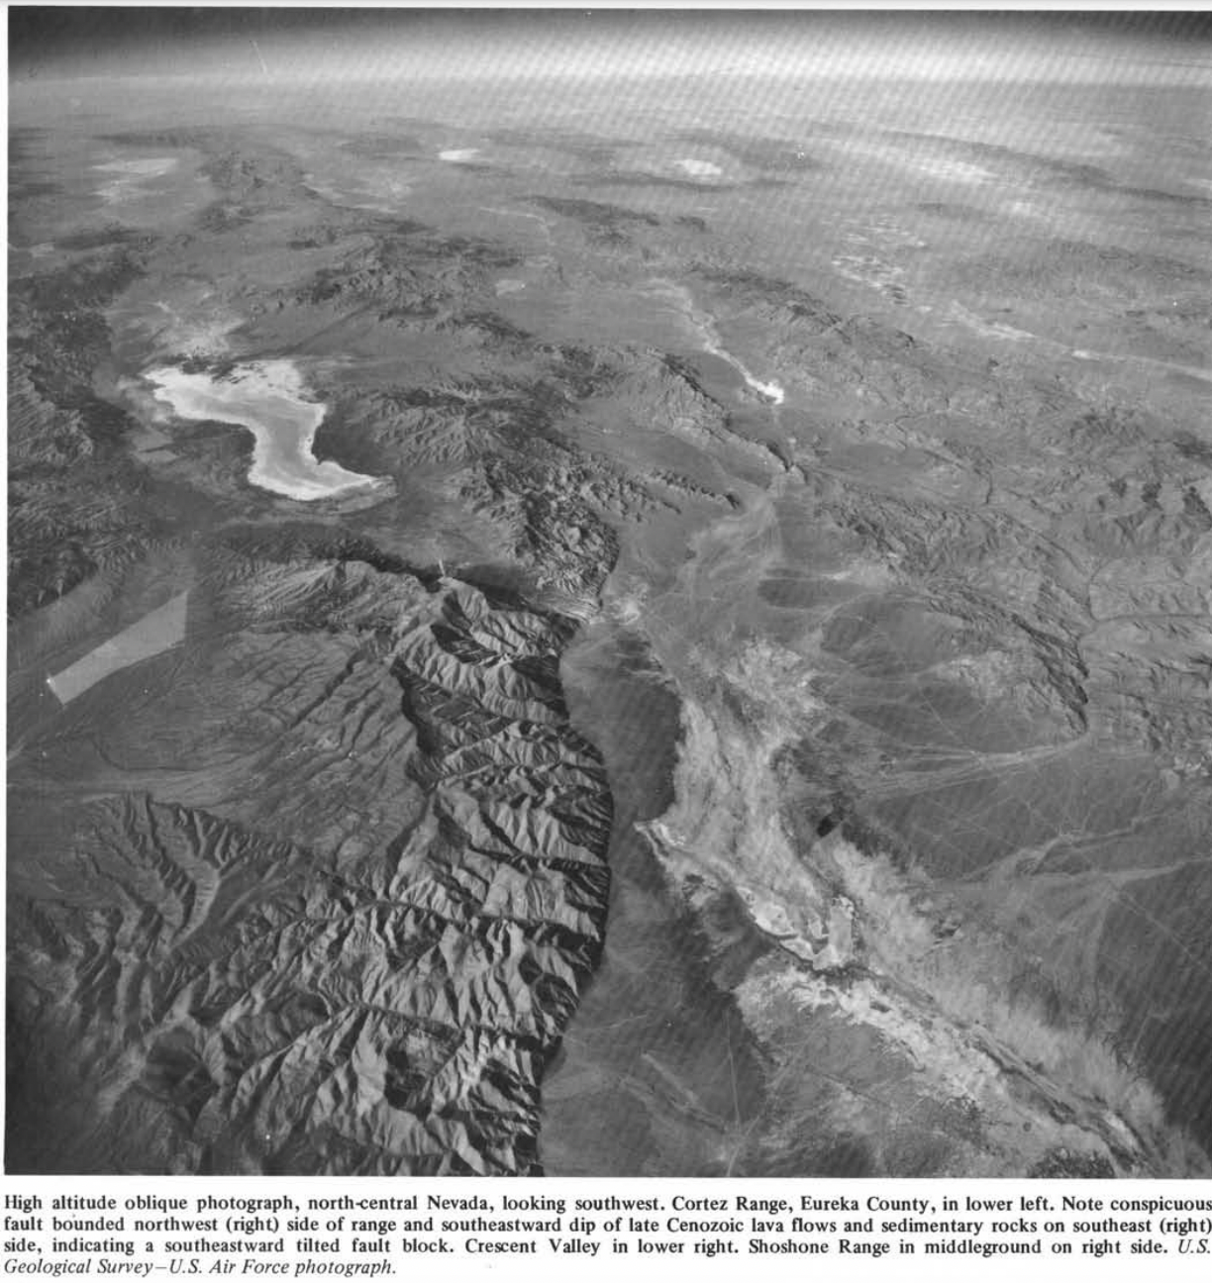
Key takeaways
Nevada was not tectonically active ~25-30 m.y. Ago.
But it was volcanically active.
~ 17 m.y. ago major changes occurred such as extensional faulting.

Slide 10
Origin Theories of extensional faulting in Nevada
Wrench faulting
Back-arc spreading
Subduction of East Pacific Rise
Mantle plumes

